Slide 1
Documentation and deployment of your code
1042.Data Science in Practice
Week 3, 03/07
http://www.cs.nccu.edu.tw/~jmchang/course/1042/datascience/
http://www.cs.nccu.edu.tw/~jmchang/course/1042/datascience/example/week3_release.zip
Reference books:
Zumel, N. & Mount, J. Practical Data Science with R. (Manning, 2014)

Slide 2
Working with R

Slide 3
Primary features of R
ASSIGNMENT
<- (Recommend)
=
? Why <-, not =
Binding values to function arguments
divide <- function(numerator, denominator) { numerator/denominator }
divide(2,1)
## [1] 2
divide(denominator=2,numerator=1)
## [1] 0.5
divide(denominator<-2,numerator<-1) # yields 2, a wrong answer
## [1] 2

Slide 4
x<-5 vs x<<-5
Demonstrating side effects
x<-1
good <- function() { x <- 5}
good()
print(x)
## [1] 1
bad <- function() { x <<- 5}
bad()
print(x)
## [1] 5

Slide 5
VECTORIZED OPERATIONS
Many R operations are called vectorized
R truth tables for Boolean operators
c(T,T,F,F) == c(T,F,T,F)
## [1] TRUE FALSE FALSE TRUE
c(T,T,F,F) & c(T,T,F,F)
## [1] TRUE FALSE FALSE FALSE
c(T,T,F,F) | c(T,F,T,F)
## [1] TRUE TRUE TRUE FALSE

Slide 6
&, | vs &&, ||
c(T,T,F,F) & c(T,T,F,F)
##TRUE TRUE FALSE FALSE
c(T,T,F,F) && c(T,T,F,F)
##TRUE
Shorter vs longer forms:
The shorter form performs elementwise comparisons in much the same way as arithmetic operators.
The longer form evaluates left to right examining only the first element of each vector. Evaluation proceeds only until the result is determined.
The longer form is appropriate for programming control-flow and typically preferred in if clauses.

Slide 7
test if two vectors are a match?
c(T,T,F,F) == c(T,F,T,F)
## [1] TRUE FALSE FALSE TRUE
> identical(c(T,T,F,F),c(T,F,T,F))
##[1] FALSE
> all.equal(c(T,T,F,F),c(T,F,T,F))
##[1] "2 element mismatches

Slide 8
Primary features of R
R IS AN OBJECT-ORIENTED LANGUAGE
> class(c(1,2))
##[1] "numeric”
R IS A FUNCTIONAL LANGUAGE
add <- function(a,b) { a + b}
add(1,2)
## [1] 3
R IS A DYNAMIC LANGUAGE
You can find all of your variables using the ls() command

Slide 9
R BEHAVES LIKE A CALL-BY-VALUE LANGUAGE
vec <- c(1,2)
fun <- function(v) { v[[2]]<-5; print(v)}
fun(vec)
## [1] 1 5
print(vec)
## [1] 1 2

Slide 10
Primary R data types
Numbers
NUMBER SEQUENCES
VECTORS
LISTS
MATRICES
DATA FRAMES
FACTORS
NULL and NA
Which one is central data structure?

Slide 11
Primary R data type - Numbers
Numbers in R are primarily represented in double-precision floating-point.
> 1/5
##[1] 0.2
> 3/5-2/5
##[1] 0.2
> 1/5==3/5-2/5
##[1] FALSE
sprintf("%.20f",1/5)
##[1] "0.20000000000000001110”
> sprintf("%.20f",3/5-2/5)
##[1] "0.19999999999999995559"
> all.equal(1/5,3/5-2/5)
##[1] TRUE

Slide 12
Primary R data type – NUMBER SEQUENCES
> 1:10
##[1] 1 2 3 4 5 6 7 8 9 10
> 1:2*5
##[1] 5 10
> 1:(2*5)
##[1] 1 2 3 4 5 6 7 8 9 10
> rep(1,10)
##[1] 1 1 1 1 1 1 1 1 1 1
> rep(10,1)
##[1] 10

Slide 13
Primary R data type – VECTORS
a<-c(1:10)
> length(a)
##[1] 10
> a[1]
##[1] 1
> a[[1]]
##[1] 1

Slide 14
[[]] vs []
> a[11]
##[1] NA
> a[[11]]
##Error in a[[11]] : subscript out of bounds
When extracting single values, we prefer the double squarebrace notation [[]] as it gives out-of-bounds warnings in situations where [] doesn’t.

Slide 15
b<-c()
> length(b)
##[1] 0
> is.null(b)
##[1] TRUE
> is.na(b)
##logical(0)
##Warning message:In is.na(b) : is.na() applied to non-(list or vector) of type 'NULL’
NULL can only occur where a vector or list is expected
NA for missing scalar values (like a single number or string).

Slide 16
vector vs list
> c(6,'fred')
##[1] "6" "fred"
list(6,'fred')
##[[1]]
##[1] 6
##[[2]]
##[1] "fred”
Lists, unlike vectors, can store more than one type of object

Slide 17
named lists
x <- list('a'=6,b='fred')
names(x)
## [1] "a" "b"
x$a
## [1] 6
x$b
## [1] "fred"
x[['a']]
## $a
## [1] 6

Slide 18
[[]] vs []
signal outof-bounds access
> c('a','b')[[7]]
##Error in c("a", "b")[[7]] : subscript out of bounds
> c('a','b')[7]
##[1] NA
[[]] unwraps the returned value
> list(a='b')['a']
##$a[1]
##"b”
> list(a='b')[['a']]
##[1] "b"
[] accept vectors as its argument
> list(a='b')[c('a','a')]
##$a
##[1] "b”
##$a
##[1] "b”
> list(a='b')[[c('a','a')]]
##Error in list(a = "b")[[c("a", "a")]] : subscript out of bounds
Really you should never use [] when [[]] can be used (when you want only a single result)

Slide 19
MATRICES
> b<-matrix(c(2,4,3,1,5,7), nrow=3,ncol=2)
> b[1,2]
##[1] 1
> b[2,1]
##[1] 4
Transpose
t(b)
cbind(b, b)
rbind(b, b)
Matrices : lists of rows, and every cell in a matrix has the same type.

Slide 20
DATA FRAMES
d = data.frame(x=c(1,2,3), y=c('x','y','z'))
Select columns
d[,1] = d[,'x'] = d[['x']] = d$x
Select rows
d[c(1,3),] = subset(d,c(1,3))

Slide 21
DATA FRAMES
The data scientist doesn’t expect to be so lucky as to find such a dataset ready for them to work with. In fact, 90% of the data scientist’s job is figuring out how to transform data into this form.
data tubing: joining data from multiple sources, finding new data sources, and working with business and technical partners

Slide 22
Matrices vs data frame
Matrices
lists of rows
every cell in a matrix has the same type
Data Frame
list of columns
different types
design
the column types
the names are the schema
the rows are the data

Slide 23
Factors
str(d)
##'data.frame': 3 obs. of 2 variables:
##$ x: num 1 2 3
##$ y: Factor w/ 3 levels "x","y","z": 1 2 3
“set of strings” for levels of categorical variables
factor('red',levels=c('red','orange'))
## [1] red
## Levels: red orange
factor('apple',levels=c('red','orange'))
## [1] <NA>
## Levels: red orange

Slide 24
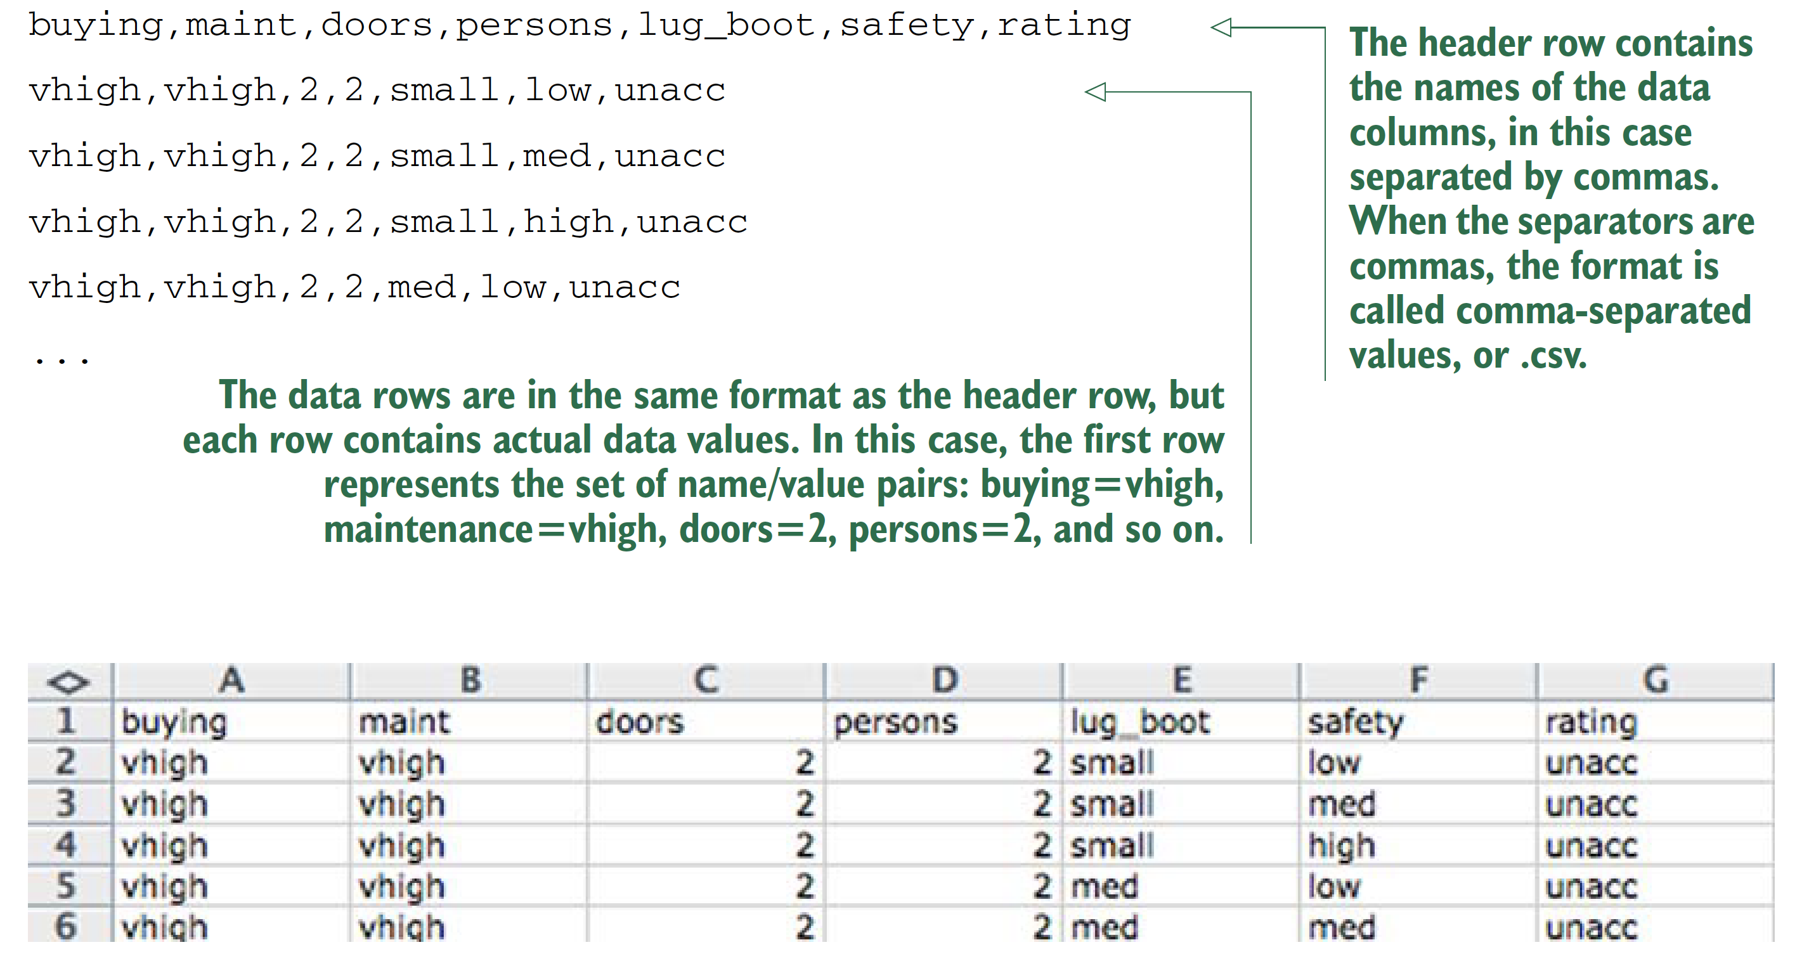
table-structured data with headers
If there is no header in data?
AVOID “BY HAND” STEPS We strongly encourage you to avoid performing any steps “by hand” when importing data. It’s tempting to use an editor to add a header line to a file, as we did in our example. A better strategy is to write a script either outside R (using shell tools) or inside R to perform any necessary reformatting.
Automating these steps greatly reduces the amount of trauma
and work during the inevitable data refresh.

Slide 25
Reading the UCI car data
uciCar <- read.table( # Note: 1
'http://www.win-vector.com/dfiles/car.data.csv', # Note: 2
sep=',', # Note: 3
header=T # Note: 4
)
# Note 1:
# Command to read from a file or URL and store the result in a new data frame object called uciCar.
# Note 2:
# Filename or URL to get the data from.
# Note 3:
# Specify the column or field separator as a comma.
# Note 4:
# Tell R to expect a header line that defines the data column names.

Slide 26
Always Exploring your data first
class(uciCar)
summary(uciCar)
dim(uciCar)
Always checking : # of rows = # of lines of text in the original file - 1

Slide 27
WORKING WITH OTHER DATA FORMATS
XLS /XLSX—http://cran.r-project.org/doc/manuals/R-data.html#Reading-Excel-spreadsheets
JSON—http://cran.r-project.org/web/packages/rjson/index.html
XML—http://cran.r-project.org/web/packages/XML/index.html
MongoDB—http://cran.r-project.org/web/packages/rmongodb/index.html
SQL—http://cran.r-project.org/web/packages/DBI/index.html

Slide 28
Using R on less-structured data
German bank credit dataset
d <- read.table(paste('http://archive.ics.uci.edu/ml/','machine-learning-databases/statlog/german/german.data',sep=''),stringsAsFactors=F,header=F)
head(d)
schema documentation or data dictionary
colnames(d) <- c('Status.of.existing.checking.account',
'Duration.in.month', 'Credit.history', 'Purpose',
'Credit.amount', 'Savings account/bonds',
'Present.employment.since',
'Installment.rate.in.percentage.of.disposable.income',
'Personal.status.and.sex', 'Other.debtors/guarantors',
'Present.residence.since', 'Property', 'Age.in.years',
'Other.installment.plans', 'Housing',
'Number.of.existing.credits.at.this.bank', 'Job',
'Number.of.people.being.liable.to.provide.maintenance.for',
'Telephone', 'foreign.worker', 'Good.Loan')
d$Good.Loan <- as.factor(ifelse(d$Good.Loan==1,'GoodLoan','BadLoan'))

Slide 29
Building a map to interpret loan use codes
mapping <- list(
'A40'='car (new)',
'A41'='car (used)',
'A42'='furniture/equipment',
'A43'='radio/television',
'A44'='domestic appliances')
http://archive.ics.uci.edu/ml/datasets/Statlog+(German+Credit+Data)

Slide 30
Transforming the car data
for(i in 1:(dim(d))[2]) { # Note: 1
if(class(d[,i])=='character') {
d[,i] <- as.factor(as.character(mapping[d[,i]])) # Note: 2
}
}
# Note 1:
# (dim(d))[2] is the number of columns in the data frame d.
# Note 2:
# Note that the indexing operator [] is vectorized. Each step in the for loop remaps an entire column of data through our list.
summary(d$Purpose)

Slide 31
Summary of Good.Loan and Purpose
the relation of loan type to loan outcome
table(d$Purpose,d$Good.Loan)

Slide 32
Summary: Loading data into R
Data frames are your friend.
Use read_table() to load small, structured datasets into R.
Always document data provenance.

Slide 33
Run R script from command line
week3_1.R
For mac:
/Library/Frameworks/R.framework/Resources/Rscript ~/Dropbox/13_NCCU/courses/資料科學實務_DataScienceInPractice/104.2/example/week3/week3_1.R

Slide 34
Passing arguments to an R script from command lines
week3_2.R
For mac:
/Library/Frameworks/R.framework/Resources/Rscript ~/Dropbox/13_NCCU/courses/資料科學實務_DataScienceInPractice/104.2/example/week3/week3_2.R ~/Dropbox/13_NCCU/courses/資料科學實務_DataScienceInPractice/104.2/example/week3/week3_2.R

Slide 35
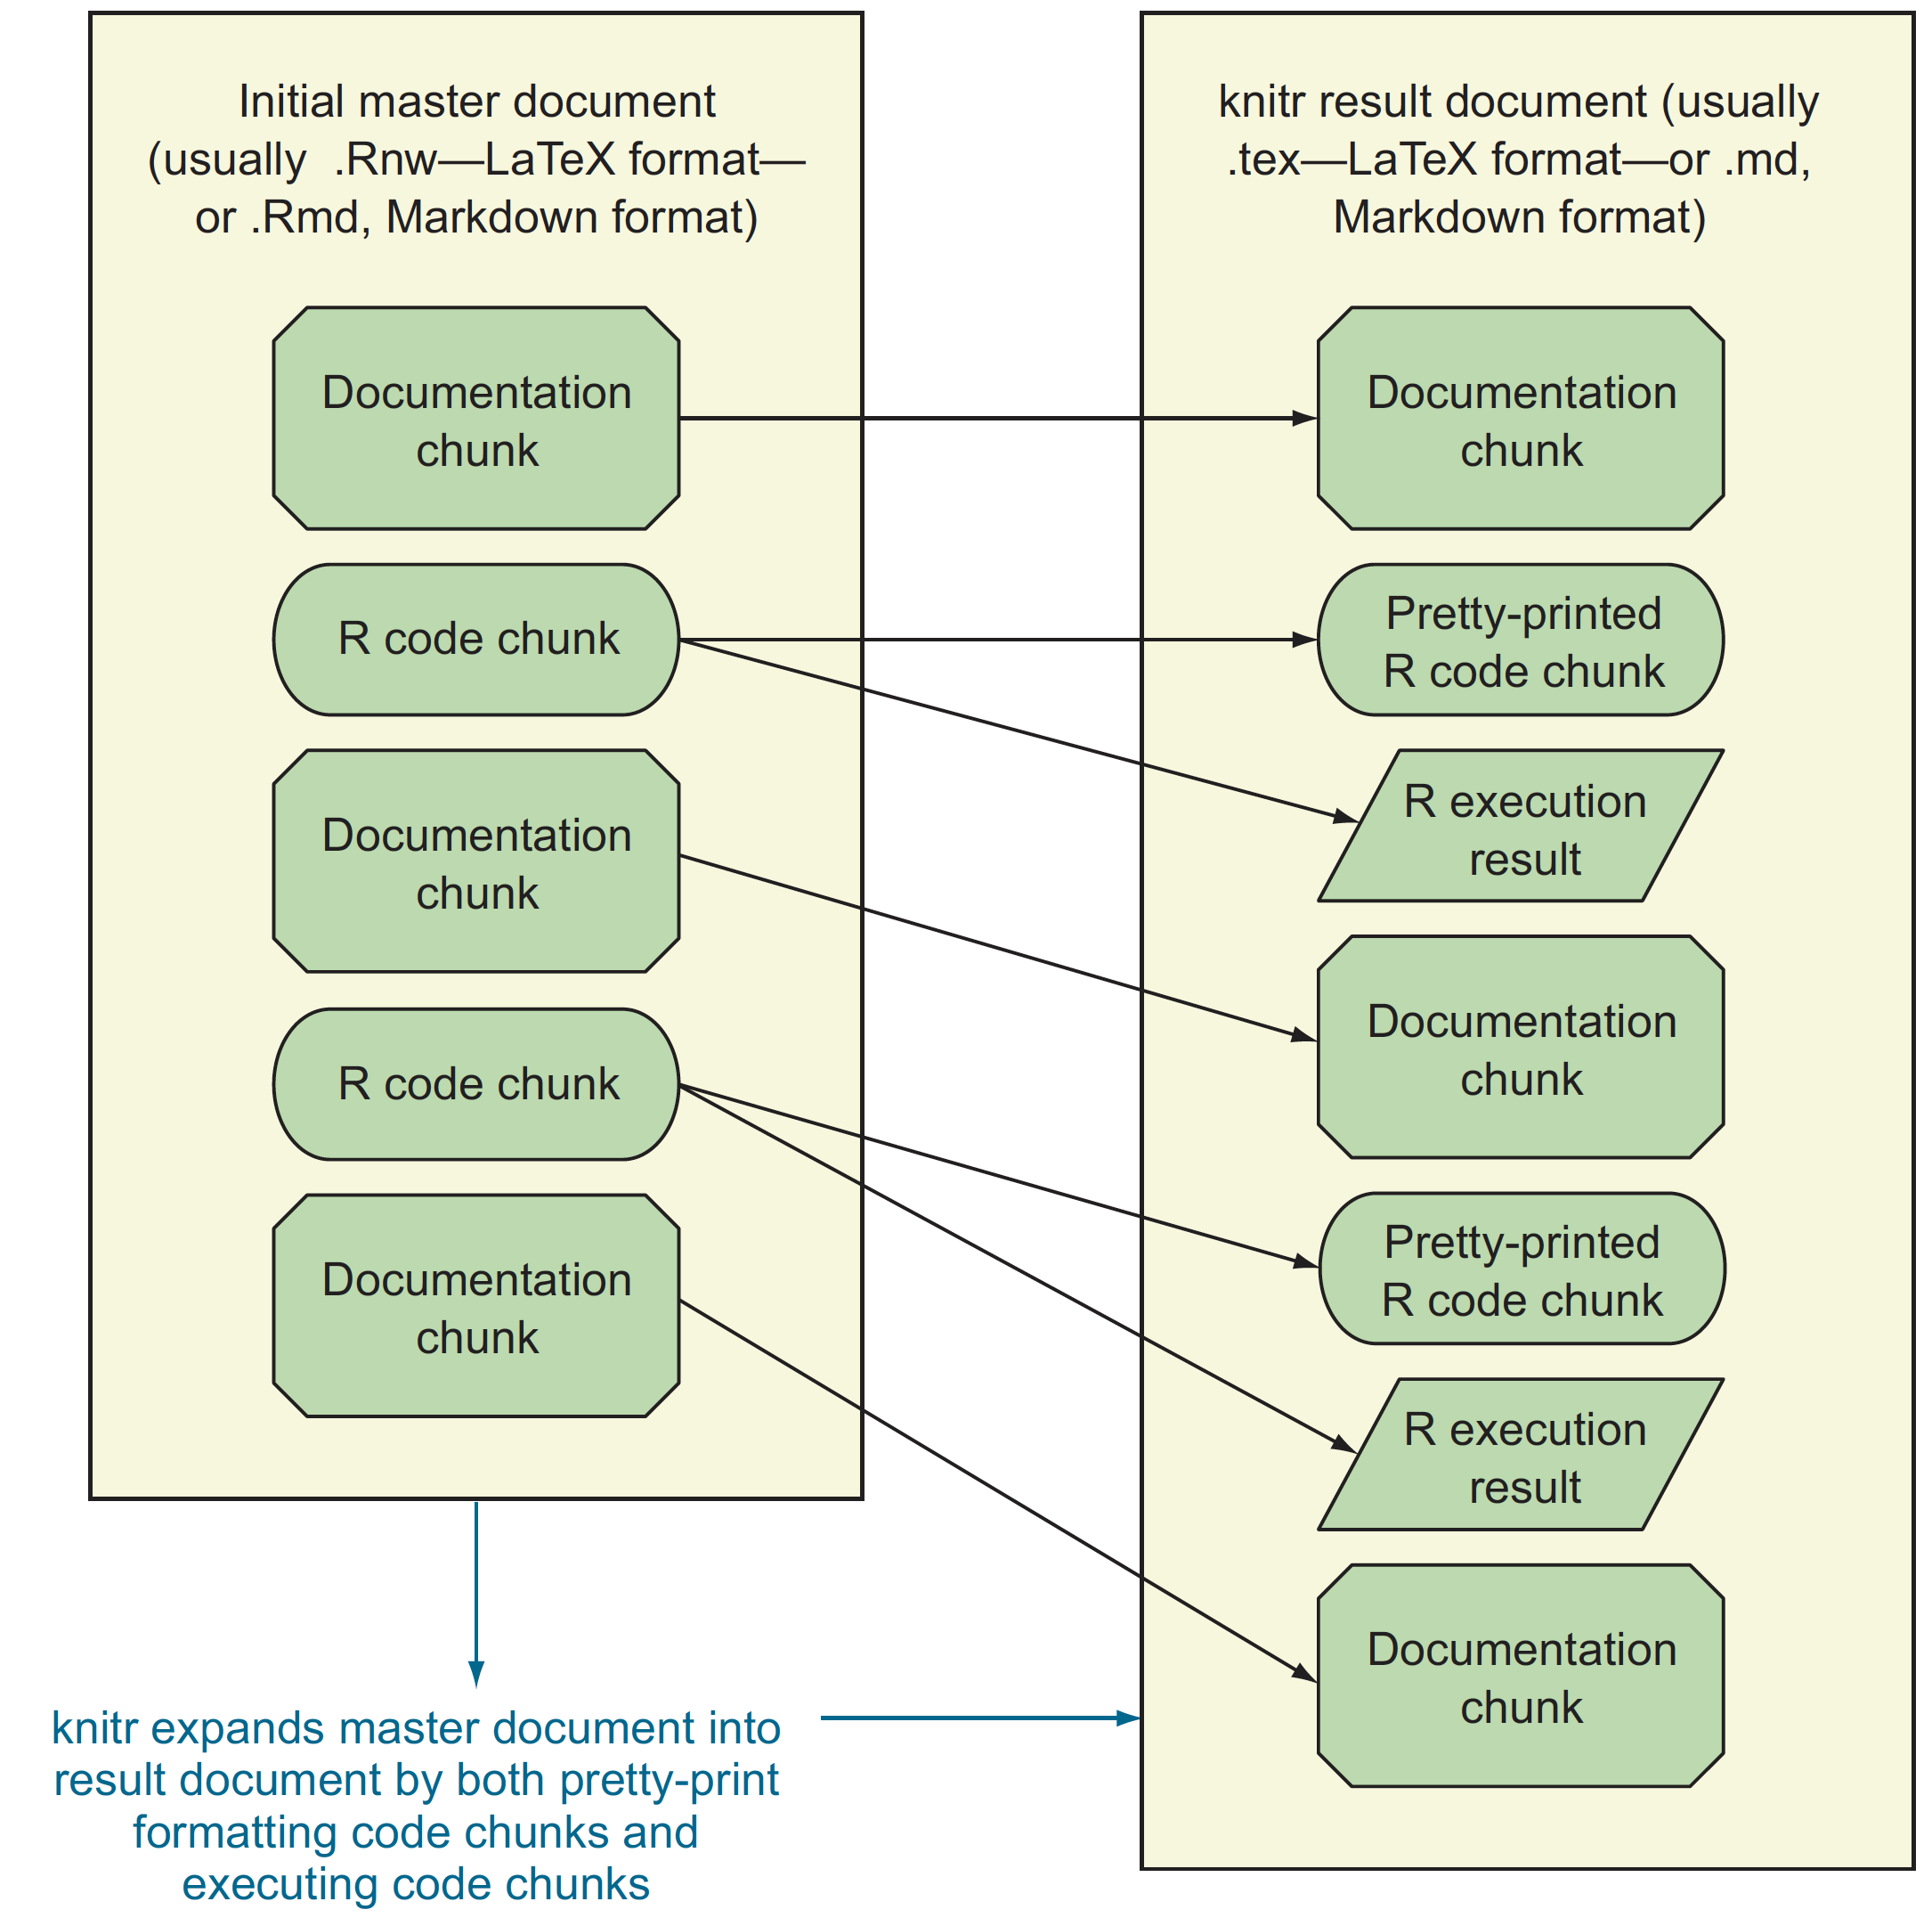
Documentation
running documentation
the form of code comment
milestone/checkpoint documentation

Slide 36
Which comment is useful?
# Return the pseudo logarithm of x, which is close to
# sign(x)*log10(abs(x)) for x such that abs(x) is large and doesn't "blow up" near zero.
# Useful for transforming wide-range variables that may be negative (like profit/loss).
# See: http://www.win-vector.com/blog/2012/03/modeling-trick-the-signed-pseudo-logarithm/
# NB: This transform has the undesirable property of making most
# signed distributions appear bimodal around the origin, no matter
# what the underlying distribution really looks like.
# The argument x is assumed be numeric and can be a vector.
pseudoLog10 <- function(x) { asinh(x/2)/log(10) }
effective comments
#######################################
# Function: addone
# Author: John Mount
# Version: 1.3.11
# Location: RSource/helperFns/addone.R
# Date: 10/31/13
# Arguments: x
# Purpose: Adds one
#######################################
addone <- function(x) { x + 1 }
Useless comments

Slide 37
How to write effective comments?
Good comments include
what the function does
what types arguments are expected to be : It’s critical to know if a function works correctly on lists, data frame rows, vectors, and so on.
limits of domain
why you should care about the function
where it’s from.
Of critical importance are any NB (nota bene or note well ) or TODO notes. It’s vastly more important to document any unexpected features or limitations in your code than to try to explain the obvious.

Slide 38
Worse than useless comment
# adds one
addtwo <- function(x) { x + 2 }

Slide 39
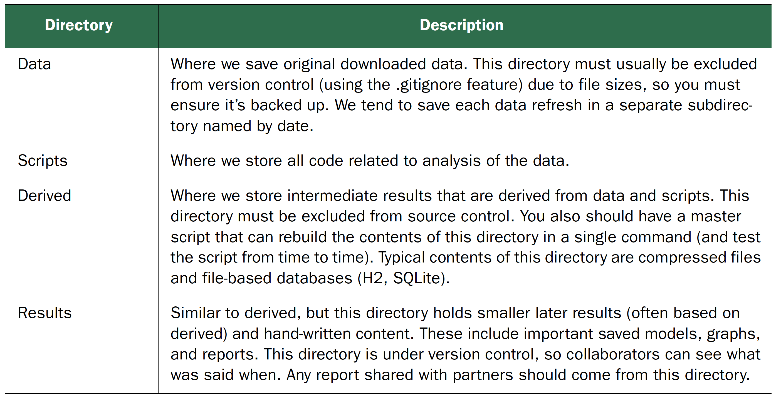
First: CHOOSING A PROJECT DIRECTORY STRUCTURE

Slide 40
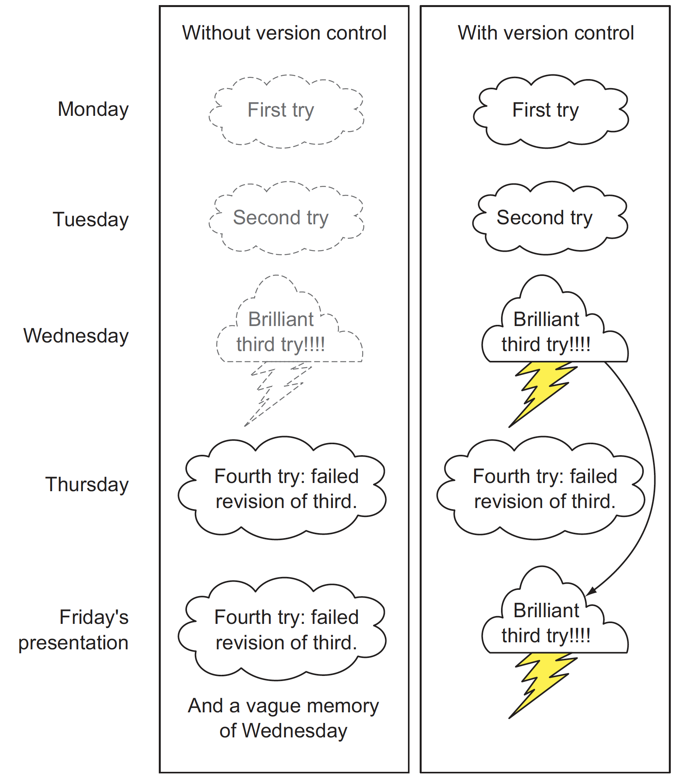
Using version control to record history

Slide 41
source code management system
a distributed version control system
The development of Git began on 3 April 2005
Torvalds quipped about the name git, which is British English slang meaning "unpleasant person”.
http://git-scm.com/video/what-is-git

Slide 42
STARTING A GIT PROJECT USING THE COMMAND LINE
Create folder
Homework1
Data
Scripts
Derived
Results
git init .
git config --global user.name "jia-ming.chang”
git config --global user.email chang.jiaming@gmail.com
git status

Slide 43
STARTING A GIT PROJECT USING THE COMMAND LINE
cp example/week3_2.R Scripts/.
touch Derived/tmp
git status
vi .gitignore
git status

Slide 44
USING ADD/COMMIT PAIRS TO CHECKPOINT WORK
git add -A .
git commit -m "include template file for homework1”
Committer: 山小王 <jiaming@jia-mingchangde-iMac.local>
Your name and email address were configured automatically based
on your username and hostname. Please check that they are accurate.
You can suppress this message by setting them explicitly. Run the
following command and follow the instructions in your editor to edit
your configuration file:
git config --global --edit
After doing this, you may fix the identity used for this commit with:
git commit --amend --reset-author
2 files changed, 35 insertions(+)
create mode 100644 .gitignore
create mode 100644 Scripts/week3_2.R
A “wimpy commit” is better than no commit

Slide 45
FINDING OUT WHO WROTE WHAT AND WHEN
git blame Scripts/week3_2.R
git log
git log --graph --name-status

Slide 46
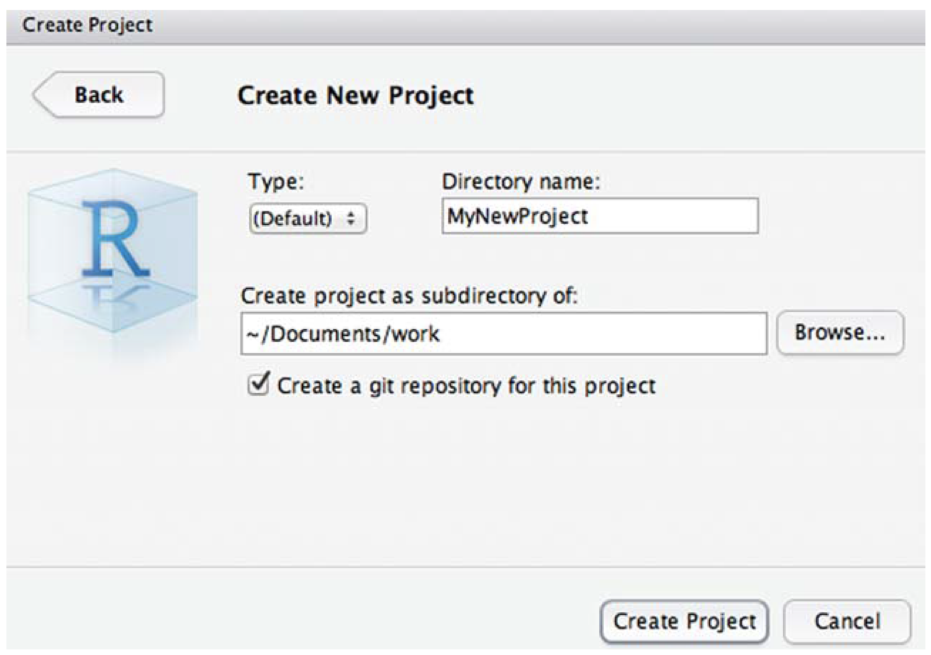
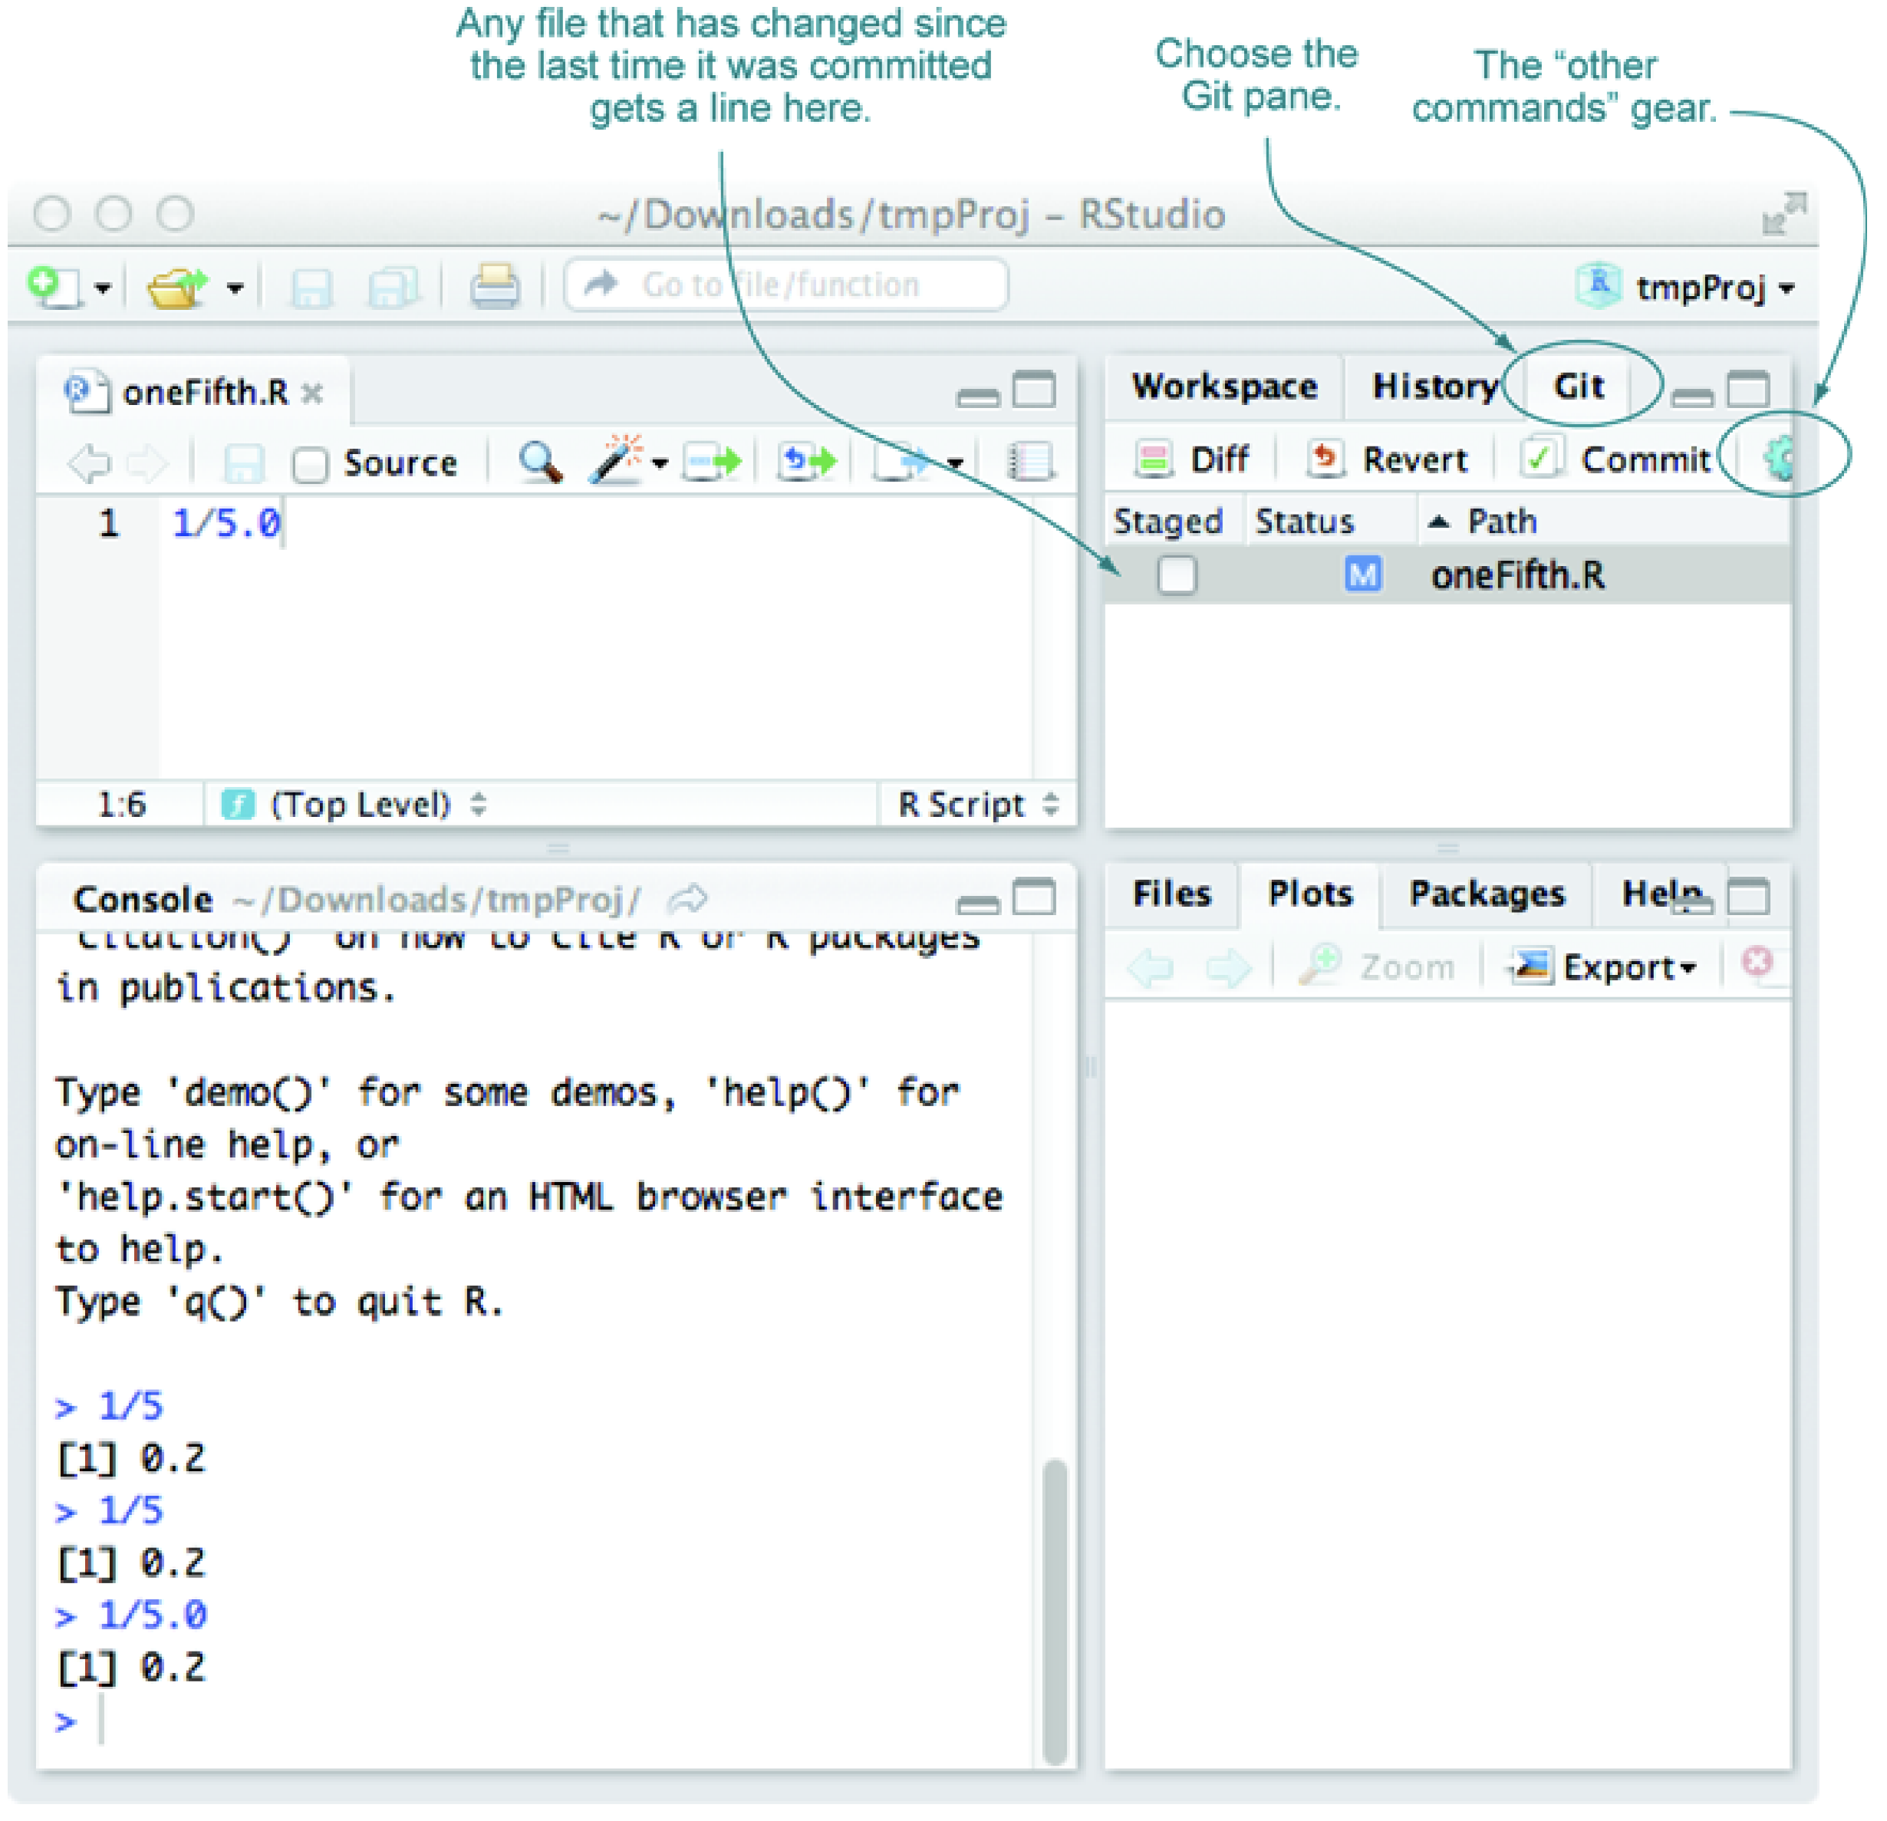
USING GIT THROUGH RSTUDIO
commit often, and if you’re committing often, all problems can be solved with some further research

Slide 47
Github
GitHub is a web-based Git repository hosting service.
Development of the GitHub platform began on 1 October 2007.
The site was launched in April 2008 by Tom Preston-Werner, Chris Wanstrath, and PJ Hyett after it had been made available for a few months prior as a beta period.
http://www.howtogeek.com/180167/htg-explains-what-is-github-and-what-do-geeks-use-it-for/

Slide 48
Git vs Github
Git is a revision control system, a tool to manage your source code history. think of it as a series of snapshots (commits) of your code. You see a path of these snapshots, in which order they where created. You can make branches to experiment and come back to snapshots you took.
GitHub is a hosting service for Git repositories. So, it is a web-page on which you can publish your Git repositories and collaborate with other people.
http://stackoverflow.com/questions/13321556/difference-between-git-and-github
http://stackoverflow.com/questions/11816424/understanding-the-basics-of-git-and-github

Slide 49
Adding an existing project to GitHub using the command line
creates a new remote called origin located at git@github.com:peter/first_app.git
git remote add origin git@github.com:warnname/1042dataScience.git
push the commits in the local branch named master to the remote named origin
git push origin master
Permission denied (publickey).
fatal: Could not read from remote repository.
Please make sure you have the correct access rights
and the repository exists.

Slide 50
Generating an SSH key
SSH keys are a way to identify trusted computers without involving passwords. You can generate an SSH key and add the public key to your GitHub account by following the procedures outlined in this section.
https://help.github.com/articles/generating-an-ssh-key/
git push origin master

Slide 51
Git commends
Local
git init .
git add -A .
git commit
git status
git log
git diff
git checkout
Public
git pull
git rebase
git push
https://www.git-tower.com/blog/git-cheat-sheet/

Slide 52
https://training.github.com/kit/downloads/github-git-cheat-sheet.pdf

Slide 53
Markdown
a simple web-ready format that’s used in many wikis
http://daringfireball.net/projects/markdown/

Slide 54
knitr-annotated Markdown
# Note 1:
# Markdown text and formatting
# Note 2:
# knitr chunk open with option
# assignments
# Note 3:
# R code
# Note 4:
# knitr chunk close
# Note 5:
# More Markdown text
# Note 6:
# Another R code chunk
# Simple knitr Markdown example # Note: 1
Two examples:
* plotting
* calculating
Plot example:
```{r plotexample, fig.width=2, fig.height=2, fig.align='center'} # Note: 2
library(ggplot2) # Note: 3
ggplot(data=data.frame(x=c(1:100),y=sin(0.1*c(1:100)))) +
geom_line(aes(x=x,y=y))
``` # Note: 4
Calculation example: # Note: 5
```{r calcexample} # Note: 6
pi*pi
```

Slide 55
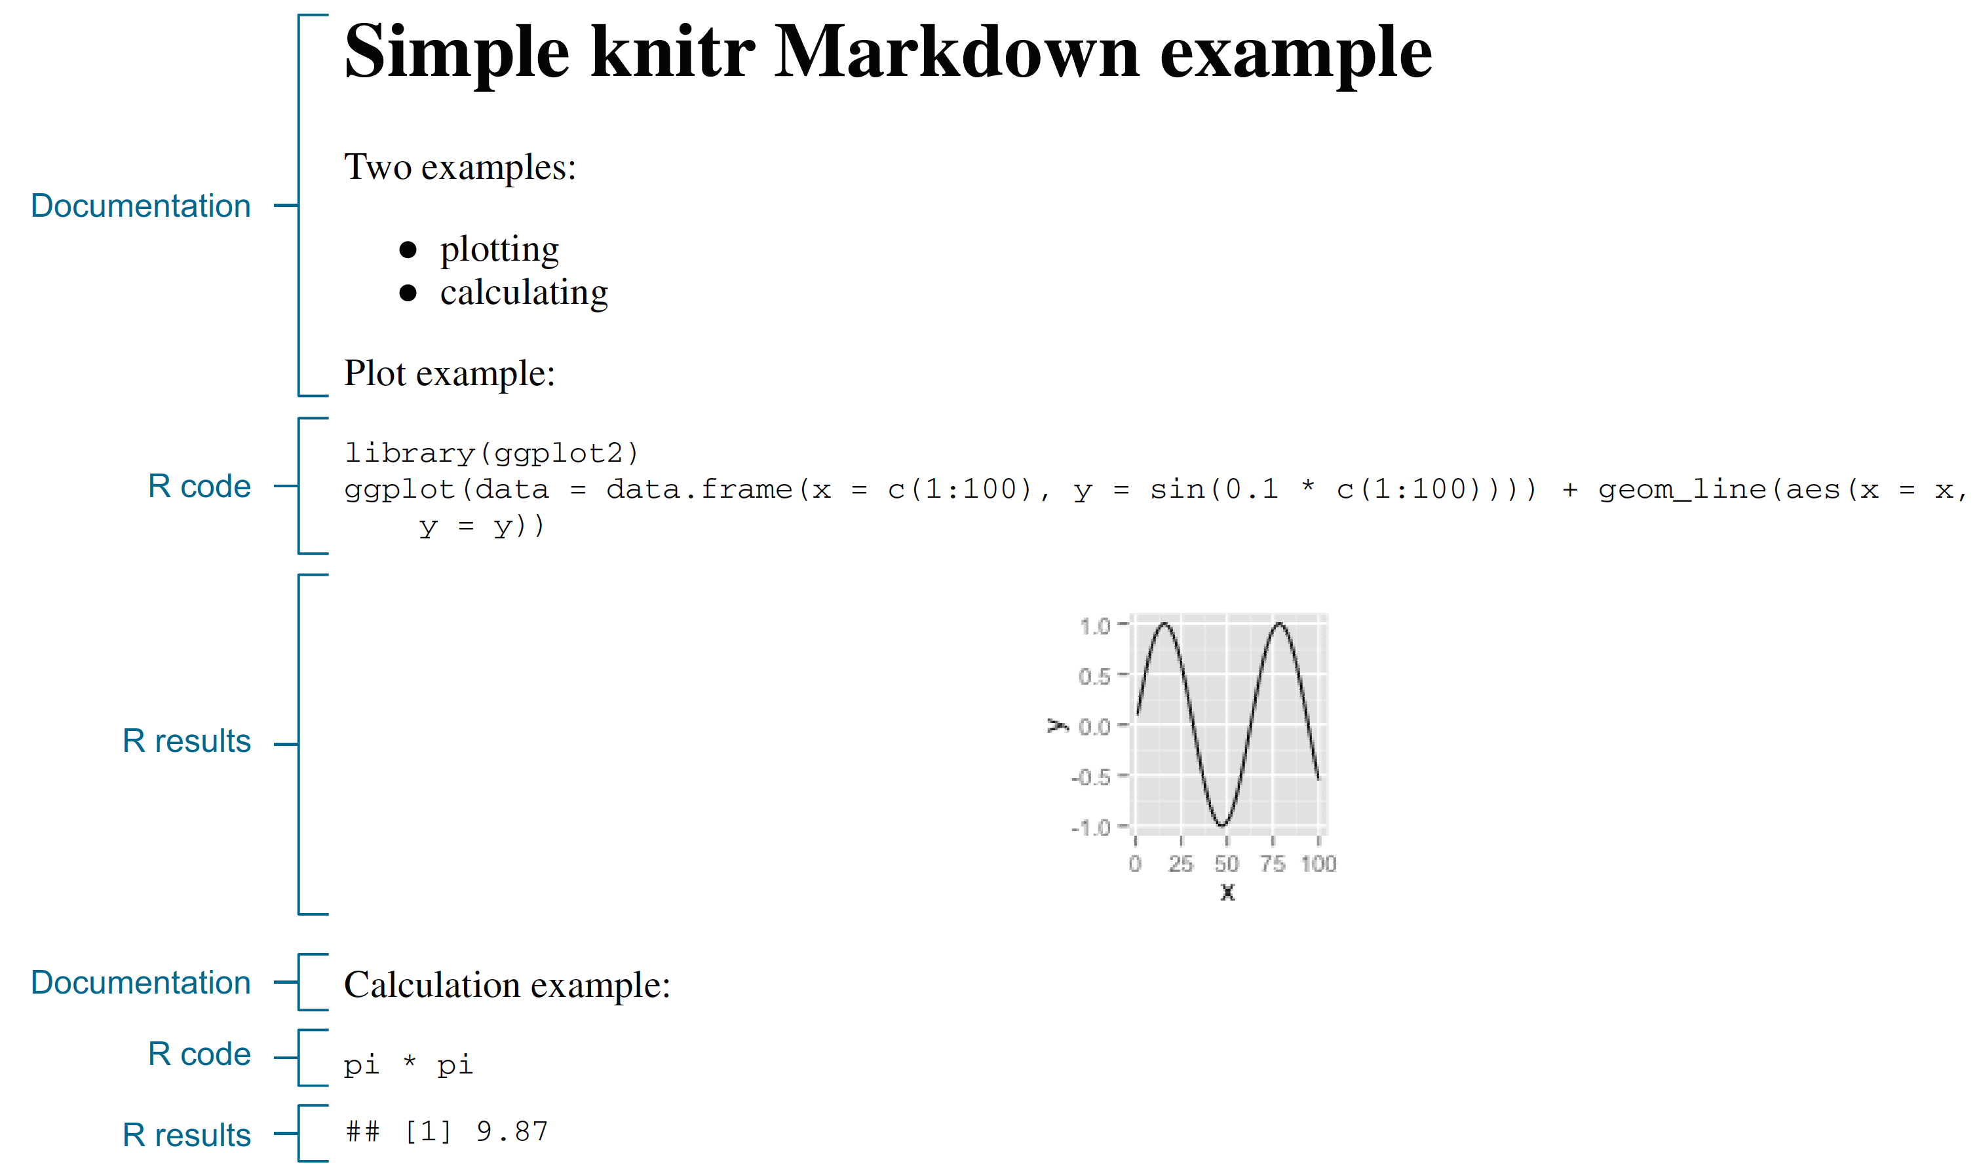
Using knitr to produce milestone documentation
library(knitr)
knit('simple.Rmd')

Slide 56
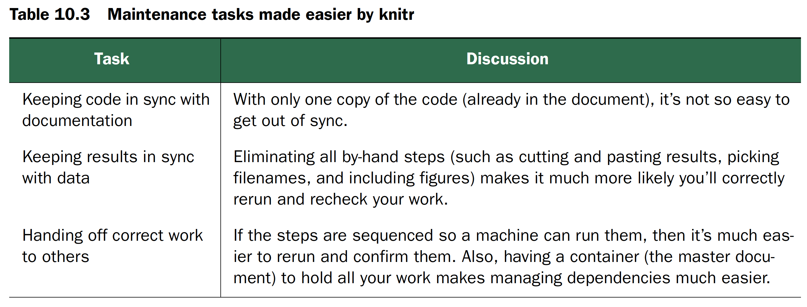
PURPOSE OF KNITR
reproducible research

Slide 57
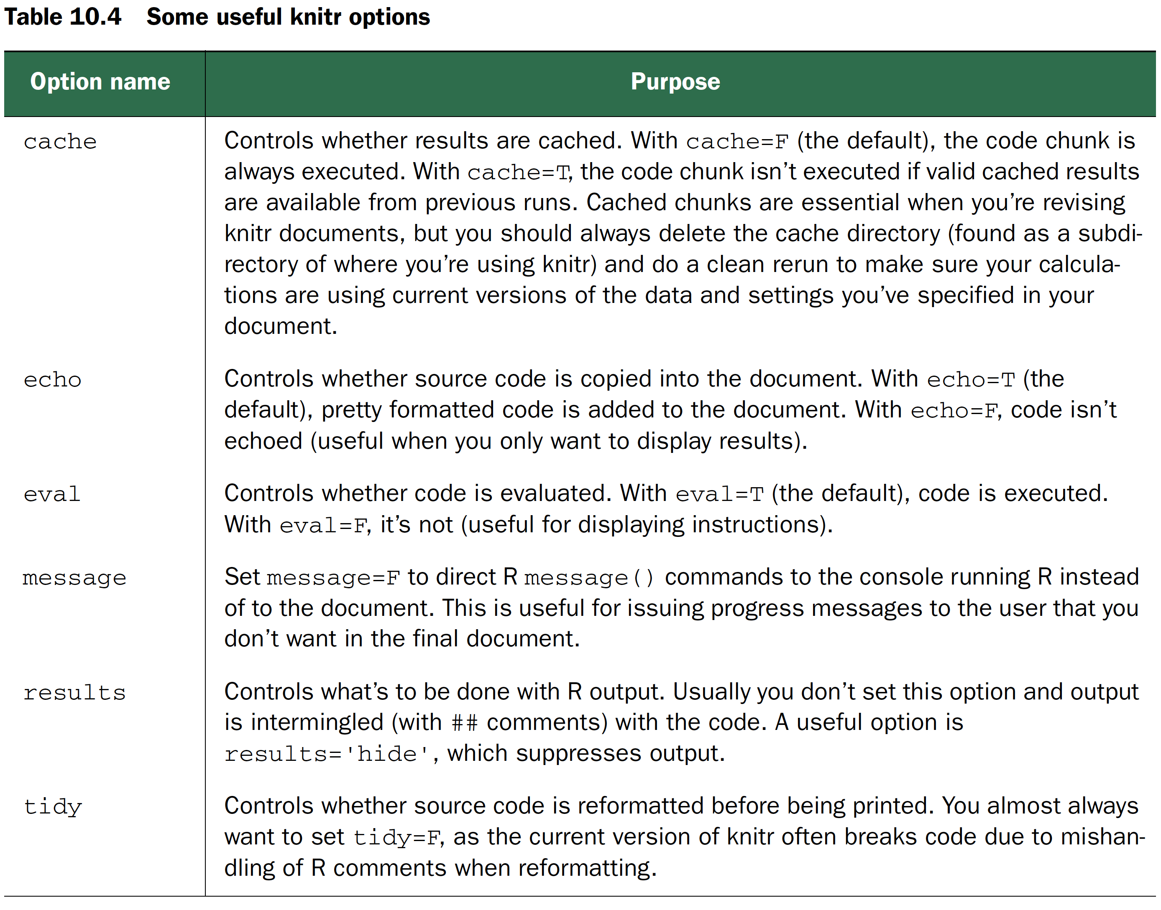
KNITR CHUNK OPTIONS
```{r calcexample} # Another R code chunk
pi*pi
```

Slide 58
Homework 1
your.R -query max/min -files file1 file2 –out out.csv
Read in multiple files & Find one file which contains the max/min one
Inputs : test.1.csv
persons,weight,height,gender
person1,92.2445889841765,182.000744945835,F
person2,79.8850586637855,199.031132040545,F
person3,65.5903067067266,180.847714091651,F
person4,92.8903334774077,190.053740092553,F
person5,95.316689889878,198.946779500693,M
person6,83.461117176339,184.001802965067,F
Output : out.csv
Type,test.1,test.2,max
weight,95.31,80.1,test.1
Height,199.03,200.11,test.2

Slide 59
Any Question?

